Slide 1
SOPHOMORE yeAR!
Classroom Guidance Fall 2019

Slide 2
GOALS FOR TODAY
Intro of Counselors
Identify possible career pathways of interest through
Exploration of world of work in relation to knowledge of self
Connection between interests and school
Ability to understand one’s individual level of school engagement and identify opportunities to increase engagement

Slide 3
Your counselors!
Javier Huerta A-Com
Maleka Allen Con-Hal
Holly Vaughn-Edmonds Ham-Log
Jessica Natonick Loh-O
Tearale Triplett P-Sn
Sue Stahl So-Z

Slide 4
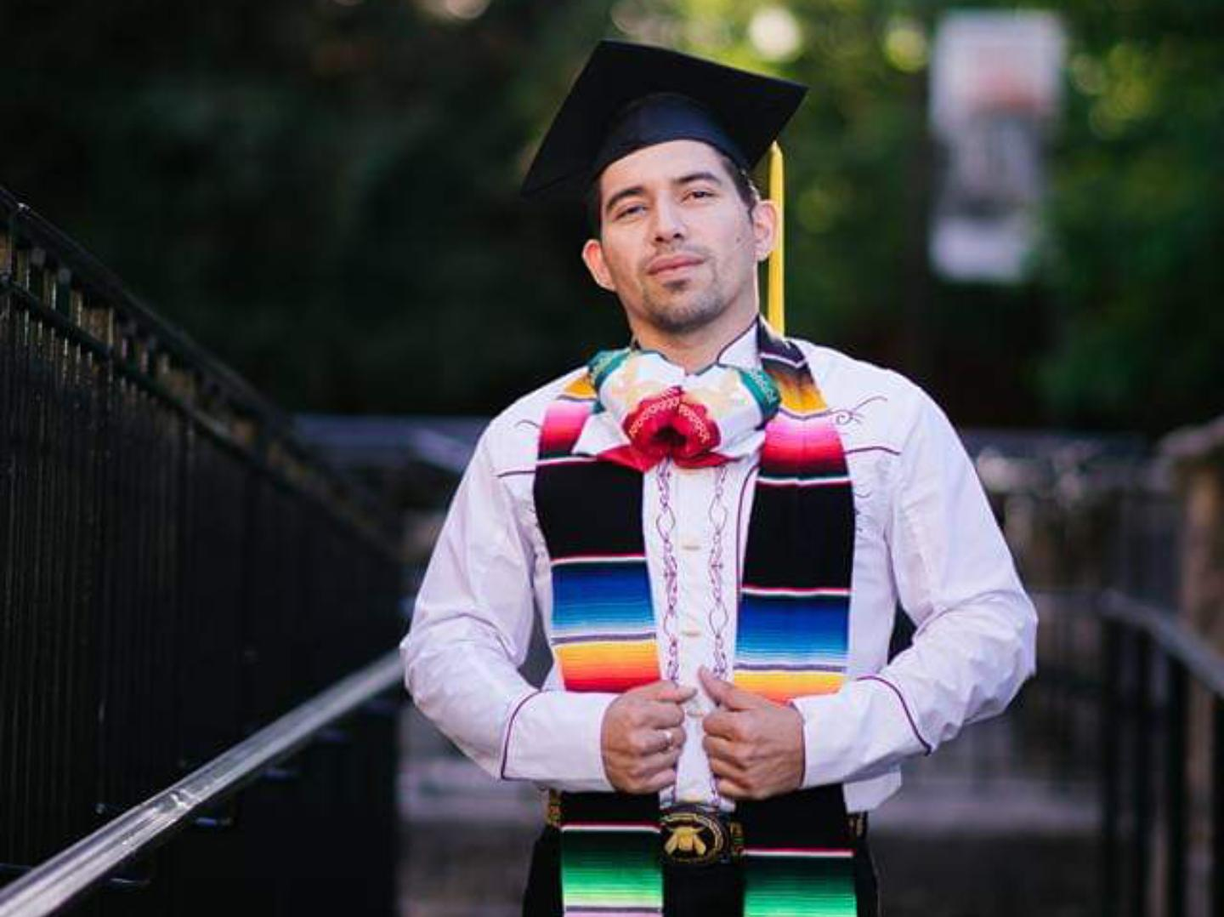
Martín was born in Southern California but grew up in Southern Oregon. He is the first in his family to graduate from high school. This past June he achieved his biggest accomplishment which was graduating from Oregon State University with a bachelors of science in Sociology. Moved to Portland over the summer and began an internship with a program called "Leap Into 9th Grade". He now comes to Franklin HS after spending a short time working at David Douglas HS as the College and Career Assistant. On his free times he likes to work on cars. His current project car is an '87 Accord which was his first car in high school. He plans to drive it down the Oregon and California coast to the Japanese Classic Car Show in 2019.

Slide 5
Sign In Google Classroom
When you get your chromebook, please sign in Google classroom. Please join the Class of 2022 using the code below.
Code: gku10j
Click on Career Interest Profile
Click on the link and take a few minutes to find what your top 3 Interest Profiles are and record them in the google classroom
Notes:
Have students click on career interest and then have them follow the instructions.

Slide 6
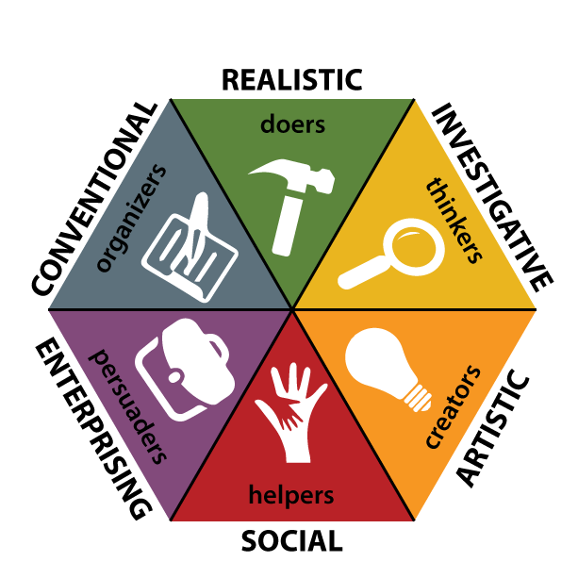
Holland’s Theory of Career Choice
Notes:
Once you answer a series of questions based on what you want and value, you will get a score in each of these areas. It does not mean that this is your only choice. It just shows where your strength and interest are right now. Realistic-Doers
Investigative-Thinkers
Artistic-Creators
Social-Helpers
Enterprising-Persuaders
Conventional-Organizers

Slide 7
REALISTIC
CONVENTIONAL
INVESTIGATIVE
ARTISTIC
ENTERPRISING
SOCIAL

Slide 8
ENGAGE WITH US ABOUT ENGAGEMENT
Results of PPS District-Wide Survey of Last Year’s Sophomores...
Only 21% of Sophomores reported feeling engaged at Franklin
Our Wonder is...why?
Why is it important to be engaged?

Slide 9
BREAKING DOWN WHAT ENGAGEMENT MEANS…….
ACADEMIC SOCIAL EXTRACURRICULAR
I ENJOY MY CLASSES I HAVE FRIENDS HERE I AM PART OF A TEAM
CTE/AP PROGRAMS ADULT RELATIONSHIPS SUN/CLUB PARTICIPATION
I’M CHALLENGED IN I HAVE FUN HERE AT FHS IN OUR ARTS PROGRAMS
CLASSES
STUDY GROUPS ATTEND SCHOOL EVENTS STEP UP
COMMUNICATING WITH I HAVE SCHOOL SPIRIT LEADERSHIP
TEACHERS
ADVANCED SCHOLAR AFFINITY GROUP POETRY SLAM
PROGRAM
Notes:
DIvide into groups: assign groups into either: Academic, Social or Extracurricular. Provide 4 minutes for group discussion: CHoose a spokesperson to report out….
Have students look at the examples of engagement within their category. Ask students to consider each example and how engaged they feel...discuss! There may be differences of opinion but we’d like to hear about discussion for each example. Also, add any additional examples you feel should be included….

Slide 10
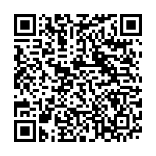
WHAT ENGAGES YOU?
Please complete this quick survey!
Scan the QR code, or find the form link in your google classroom.

Slide 11
Connect with us!!!!!
Javier Huerta: jhuerta@pps.net
Maleka Allen: mallen1@pps.net
Holly Vaughn-Edmonds: hvedmonds@pps.net
Jessica Natonick: jnatonick@pps.net
Tearale Triplett: ttriplett@pps.net
Sue Stahl: sstahl@pps.net

Slide 12
SEE YOU EARLY NEXT YEAR FOR
forecasting!!

